Slide 1

Jeff Nguyen and Ernesto Frausto

Slide 2
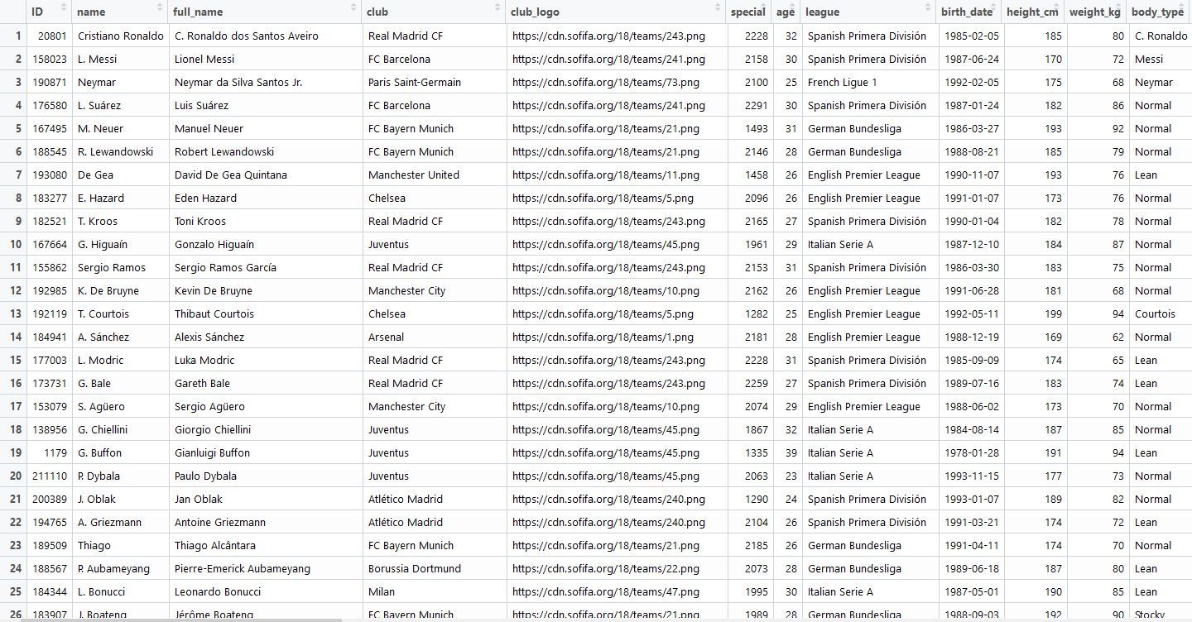
Background
FIFA 18 is the most widely played video game in the world
Data retrieved from EA Sports- publicly available on their website
Population size over 17000 (all pro athletes worldwide)
Large population size makes every variable significant
Difficult to predict values from an inflated prediction equation

Slide 3
So…
We created a random sample of n = 200
R function
set.seed(12)
prelim_sample <- data.table(data)
random_sample <- prelim_sample[sample(.N, 200)]
attach(random_sample)

Slide 4
Question
Is the ball control of a player affected by other variables?
Ball control- ability to keep possession of the ball and dictate where the ball will go

Slide 5
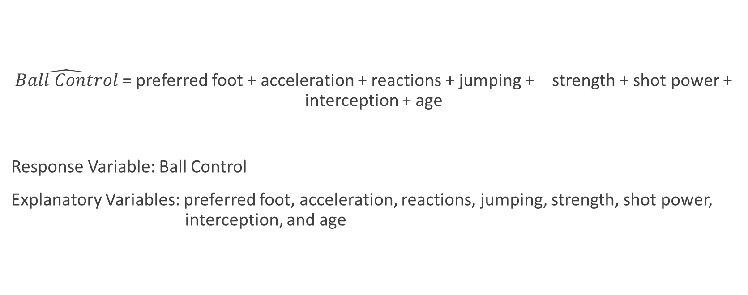
Multiple Regression Model
$\hat{Ball Control}$= preferred foot + acceleration + reactions + jumping + strength + shot power + interception + age
Response Variable: Ball Control
Explanatory Variables: preferred foot, acceleration, reactions, jumping, strength, shot power, interception, and age

Slide 6
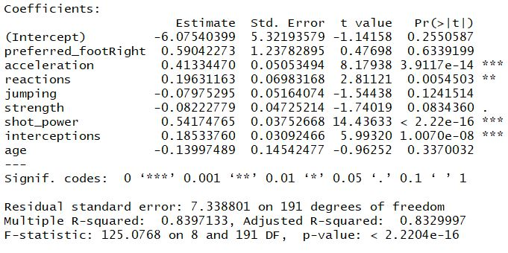
Adjusted R-squared, F-statistic, and models p-value indicate a good model

Slide 7
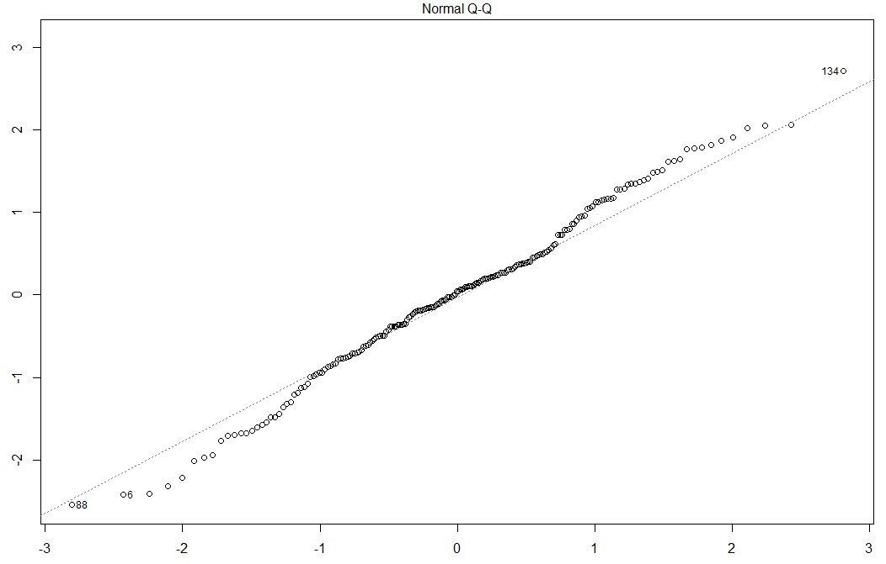
BUT…
High p-values
Preferred_footRight
Age
Jumping
Strength
AND

Slide 8
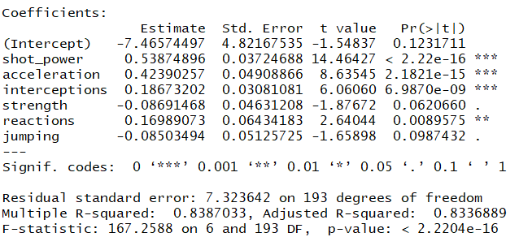
Forward Selection
Forward and Backward selection gave the same results
P-values still high for:
Strength
Jumping
Adjusted R-squared higher when strength and jumping are kept

Slide 9
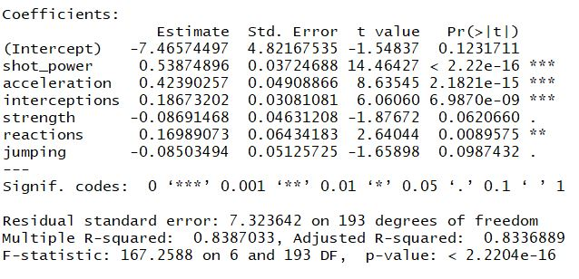
Output
Multiple R-squared = 83.9%
.8387 of the variation of y can be accounted by the regression model
Adjusted R- squared = 83.4%
Punishes for many insignificant variables
Indicates variables are a good fit

Slide 10
Overall Output
F-statistic= 167.26
P-value < 2.22-16
Reject null; there is statistically significant evidence of a relationship
Stander error= 7.32 on 193 df
High standard error
Indicates relationship

Slide 11
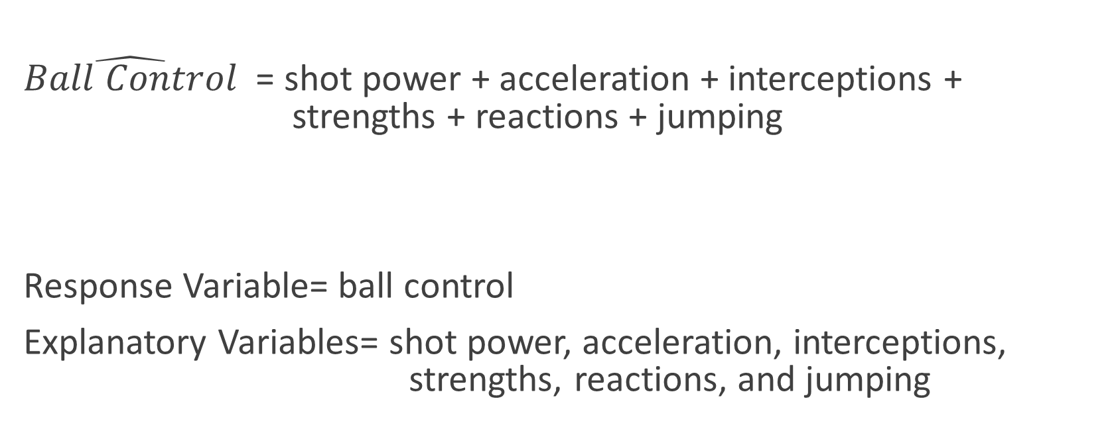
Final Regression Model
$\hat{Ball Control}$ = shot power + acceleration + interceptions + strengths + reactions + jumping
Response Variable= ball control
Explanatory Variables= shot power, acceleration, interceptions, strengths, reactions, and jumping

Slide 12
Assumptions
Linearity assumption: residuals plot shows no curve
Homoscedasticity: residuals plot shows no fan shape
Normality: residuals are nearly normal with no significant outliers
Independence: samples were randomly selected from the population

Slide 13
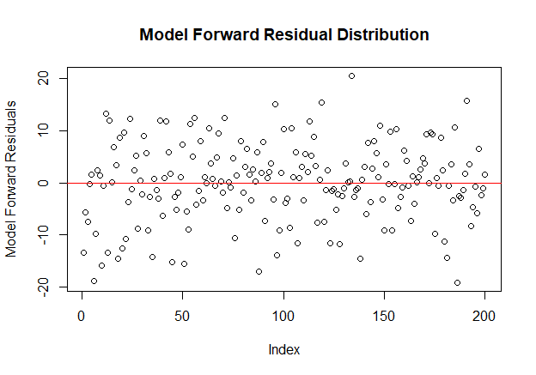
Checking Assumptions- Residuals

Slide 14
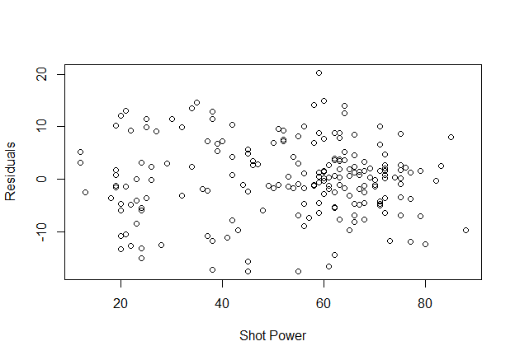
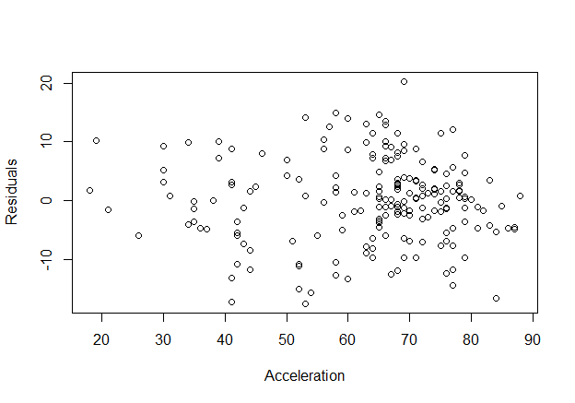
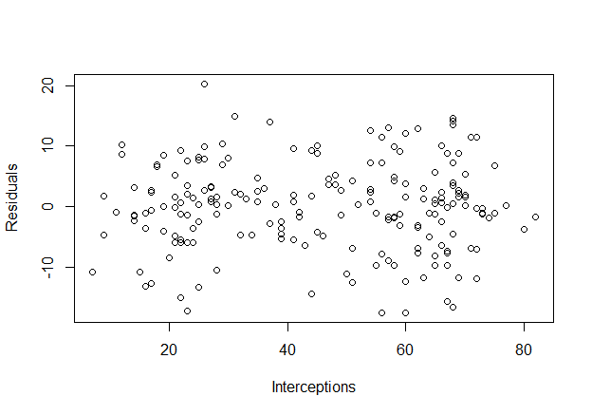
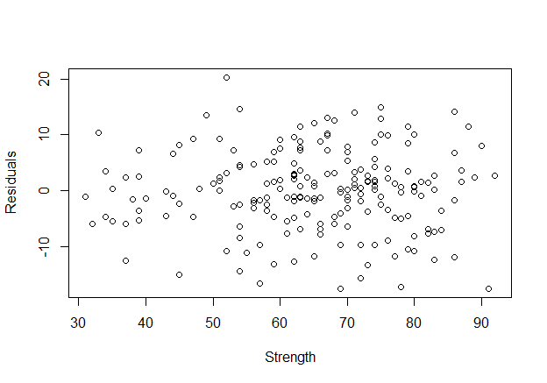
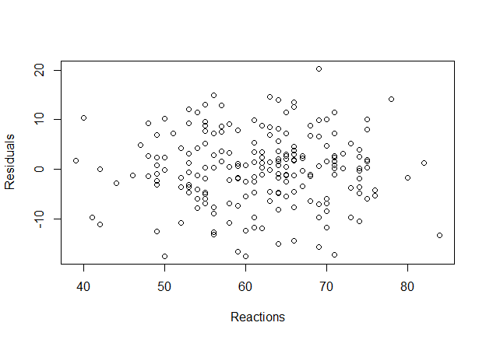
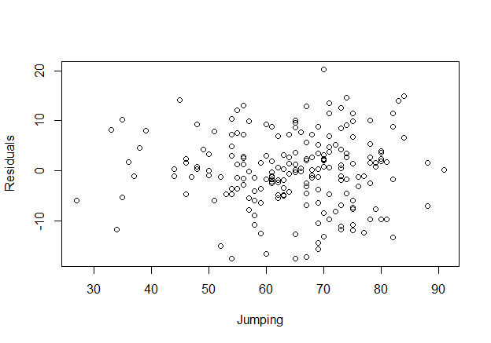
Individual Residual Plots

Slide 15
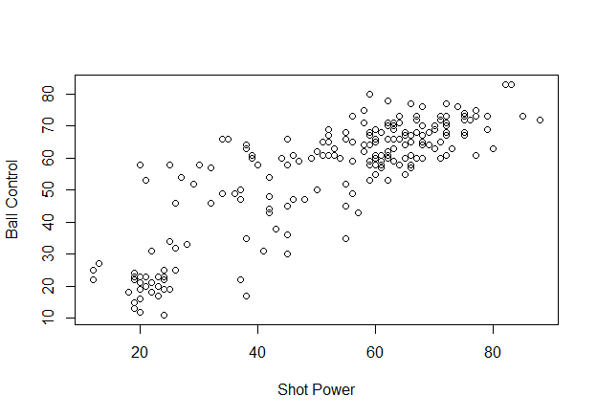
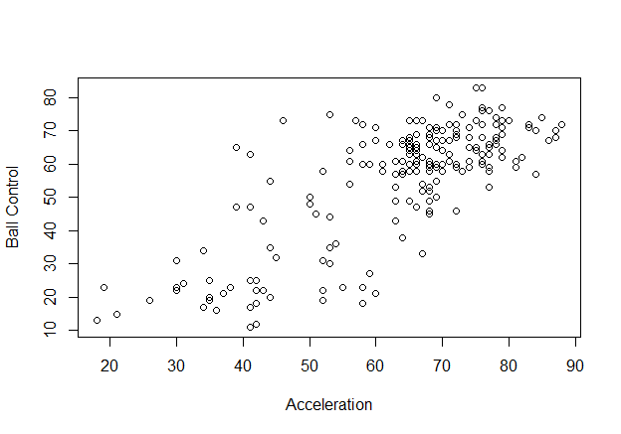
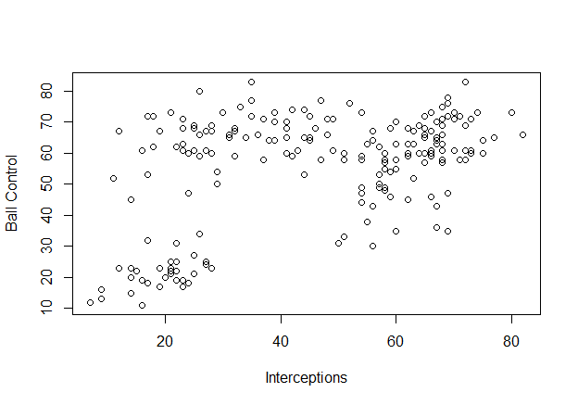
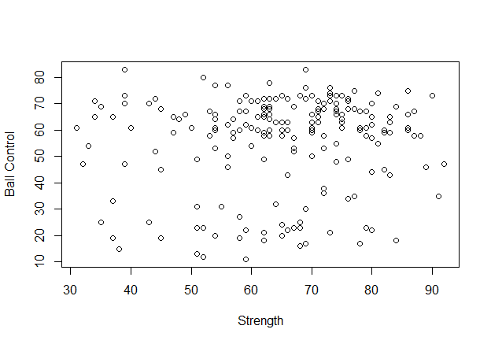
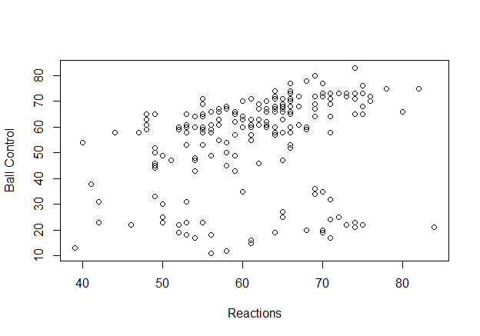
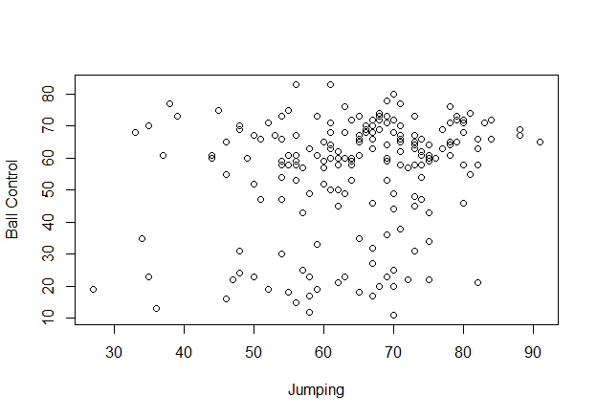
Response vs Explanatory Plots

Slide 16
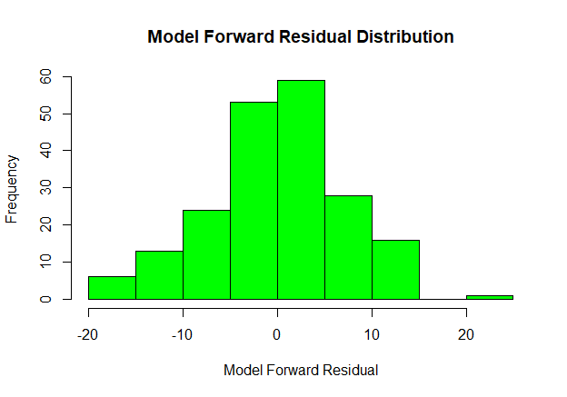
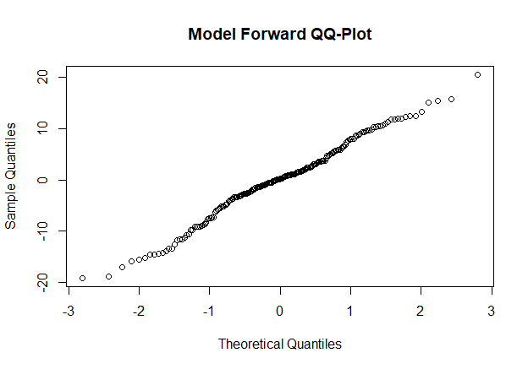
Checking Assumptions- Normality

Slide 17
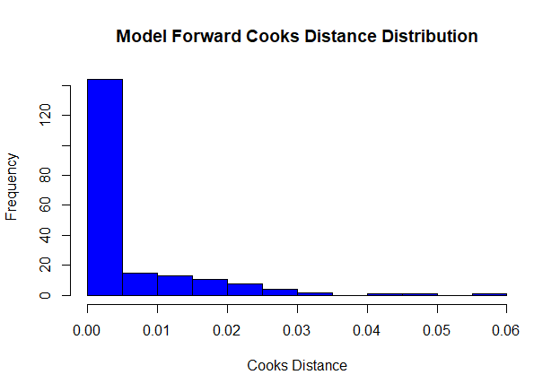
Checking Assumptions- cooks.distance and vif
Cooks.distance shows an outlier, but it isn’t significantly influential
Variance Inflation Factors
< 5
No multicollinearity

Slide 18
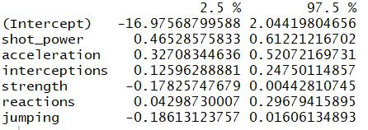
Confidence Intervals
The confint model gives 95% confidence intervals for the model’s variables

Slide 19
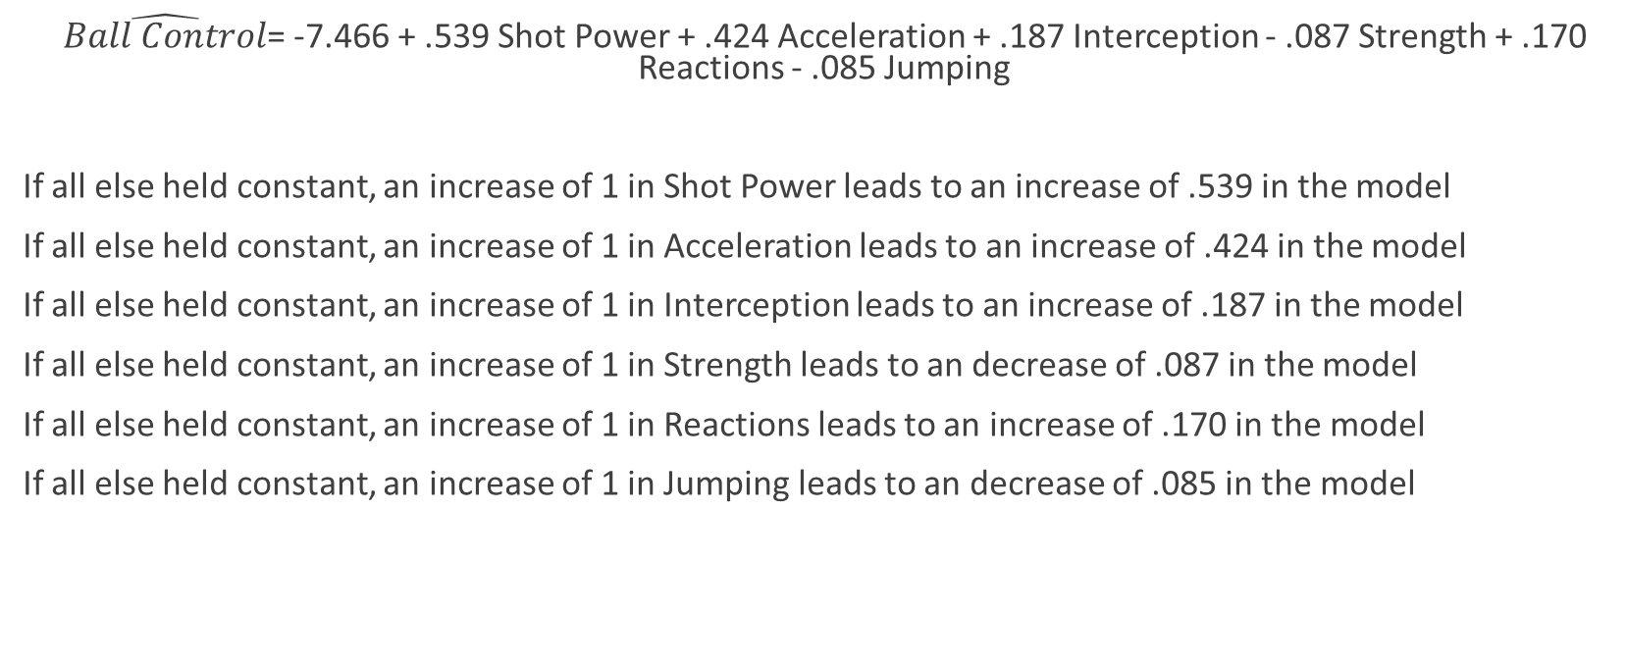
Equation
$\hat{Ball Control}$= -7.466 + .539 Shot Power + .424 Acceleration + .187 Interception - .087 Strength + .170 Reactions - .085 Jumping
If all else held constant, an increase of 1 in Shot Power leads to an increase of .539 in the model
If all else held constant, an increase of 1 in Acceleration leads to an increase of .424 in the model
If all else held constant, an increase of 1 in Interception leads to an increase of .187 in the model
If all else held constant, an increase of 1 in Strength leads to an decrease of .087 in the model
If all else held constant, an increase of 1 in Reactions leads to an increase of .170 in the model
If all else held constant, an increase of 1 in Jumping leads to an decrease of .085 in the model

Slide 20
Conclusion
High Multiple and Adjusted R-squared suggest the model is a good fit
Low p-value for the model shows a statistically significant relationship
Most p-values for the coefficients are statistically significant
Higher p-values are still moderately small
Coefficients with high p-values increase the overall model as shown through the Adjusted R-squared
Ultimately, ball control is affected by many variables!

Slide 21
Limitations
Our model is based of a sample of 200 players
Difficult to predict 18000 players from our equation
A larger sample size could change the model
We could improve the model by:
Increasing the sample size
Studying how our random sample players change throughout the years to see if model fits
Consider amateurs and professionals instead of only professionals

